Slide 1
M1 Mini Operation Guide
Home Care Business Unit
Geena Gao

Slide 2
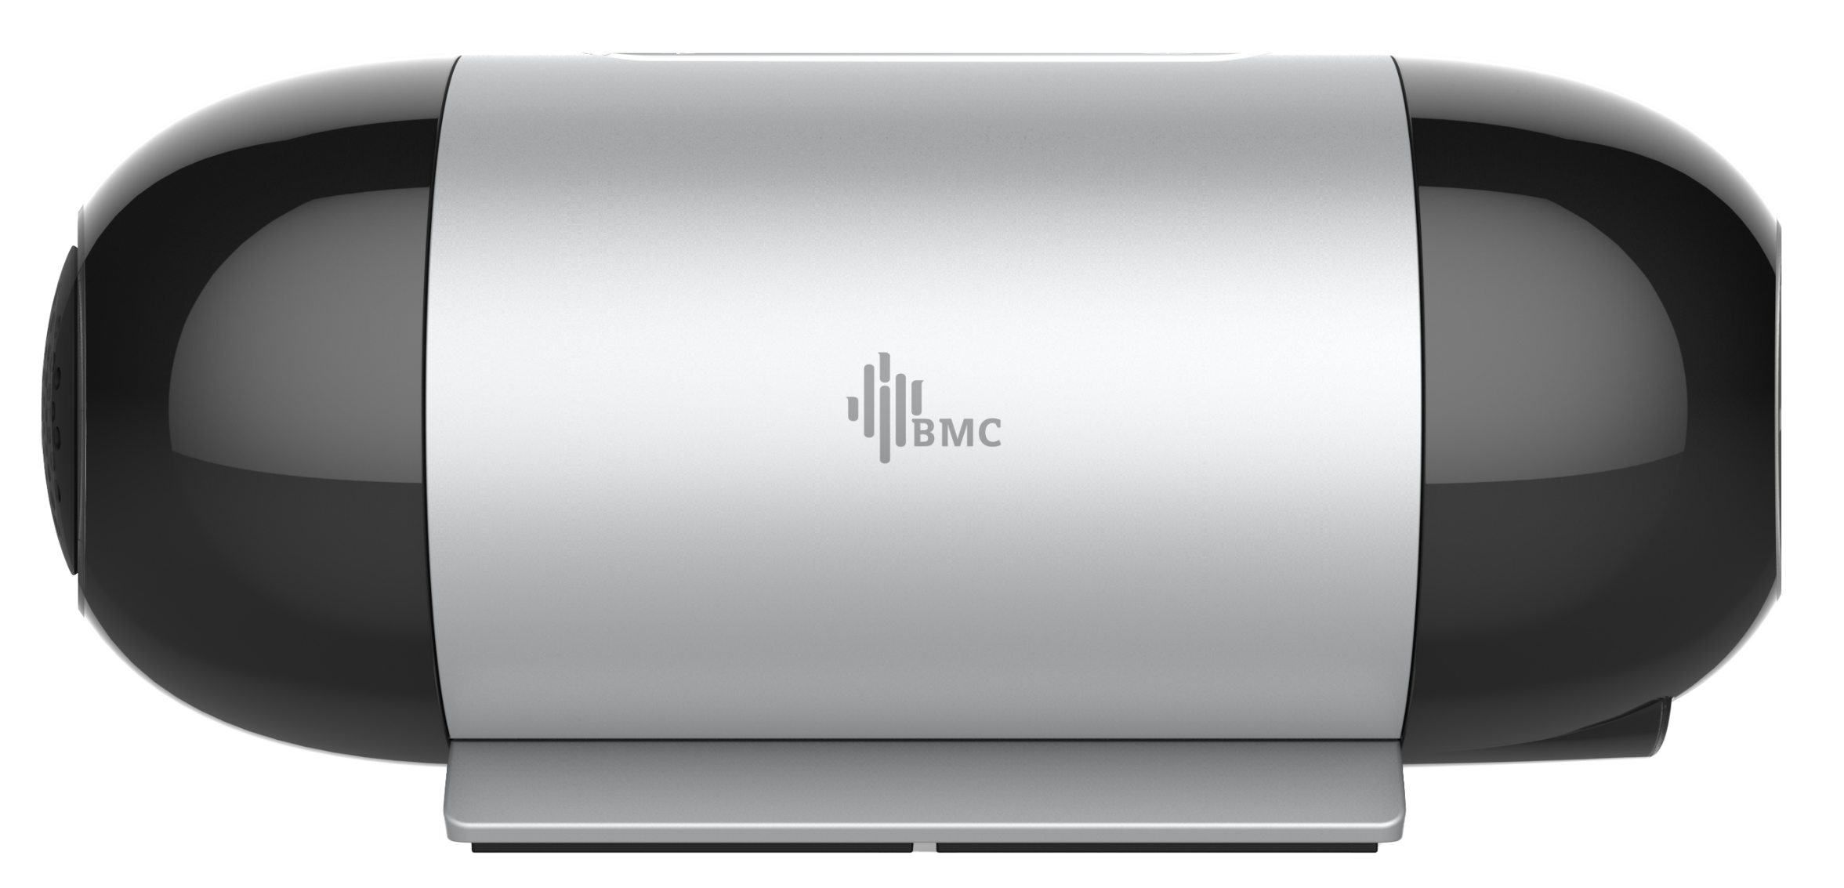
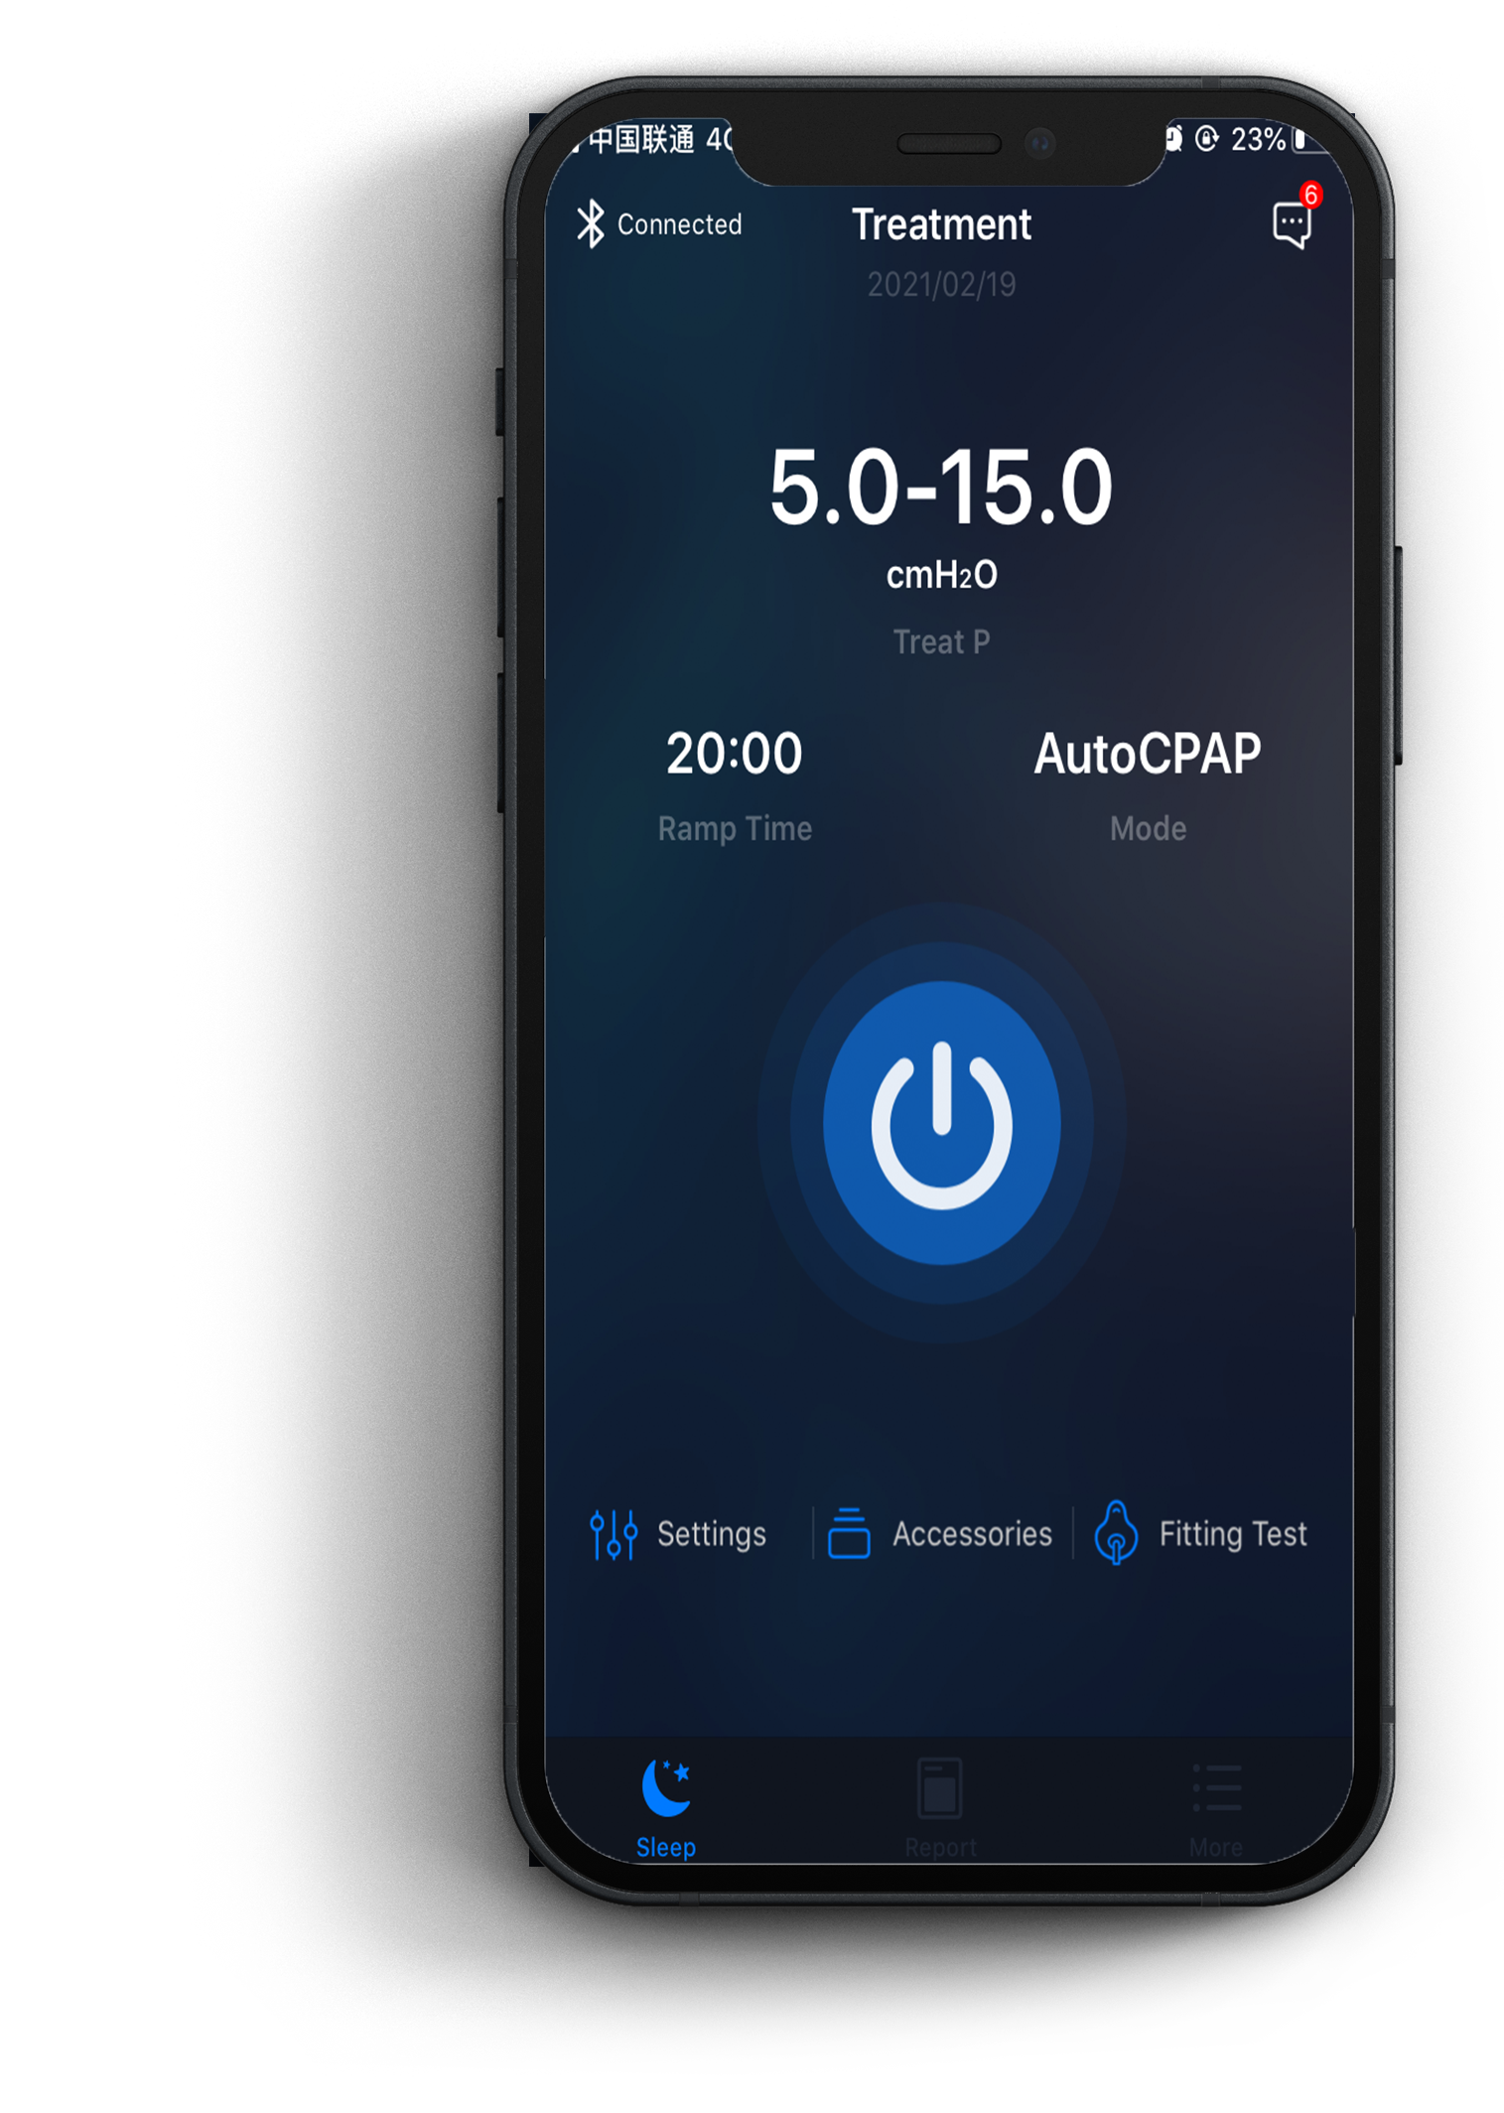

1
BMC M1 Mini
The M1 Mini Auto CPAP system is an automatic pressure adjusting CPAP device designed for the treatment of Snoring and Obstructive Sleep Apnea and Hypopnea Syndrome (OSAHS).
Mini APP is a control software of Mini Serial device. Users can adjust parameters, control the running state and check the treatment condition by Mini APP.

Slide 3
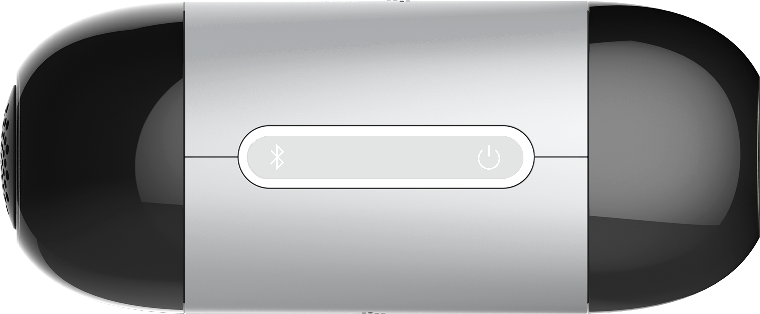


2
Brief description of the device
Treatment Start/Stop
White light is on when there the device is turned on and the mask is removed.
Orange-red light is on when there is a prompt.

Slide 4

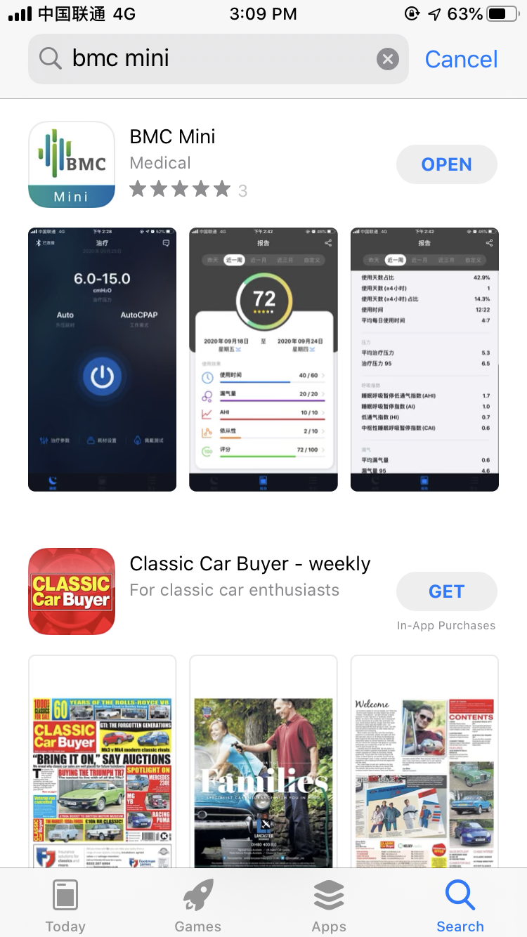


3
Download and Install
Type in BMC Mini
Find the App, click “Download”

Slide 5
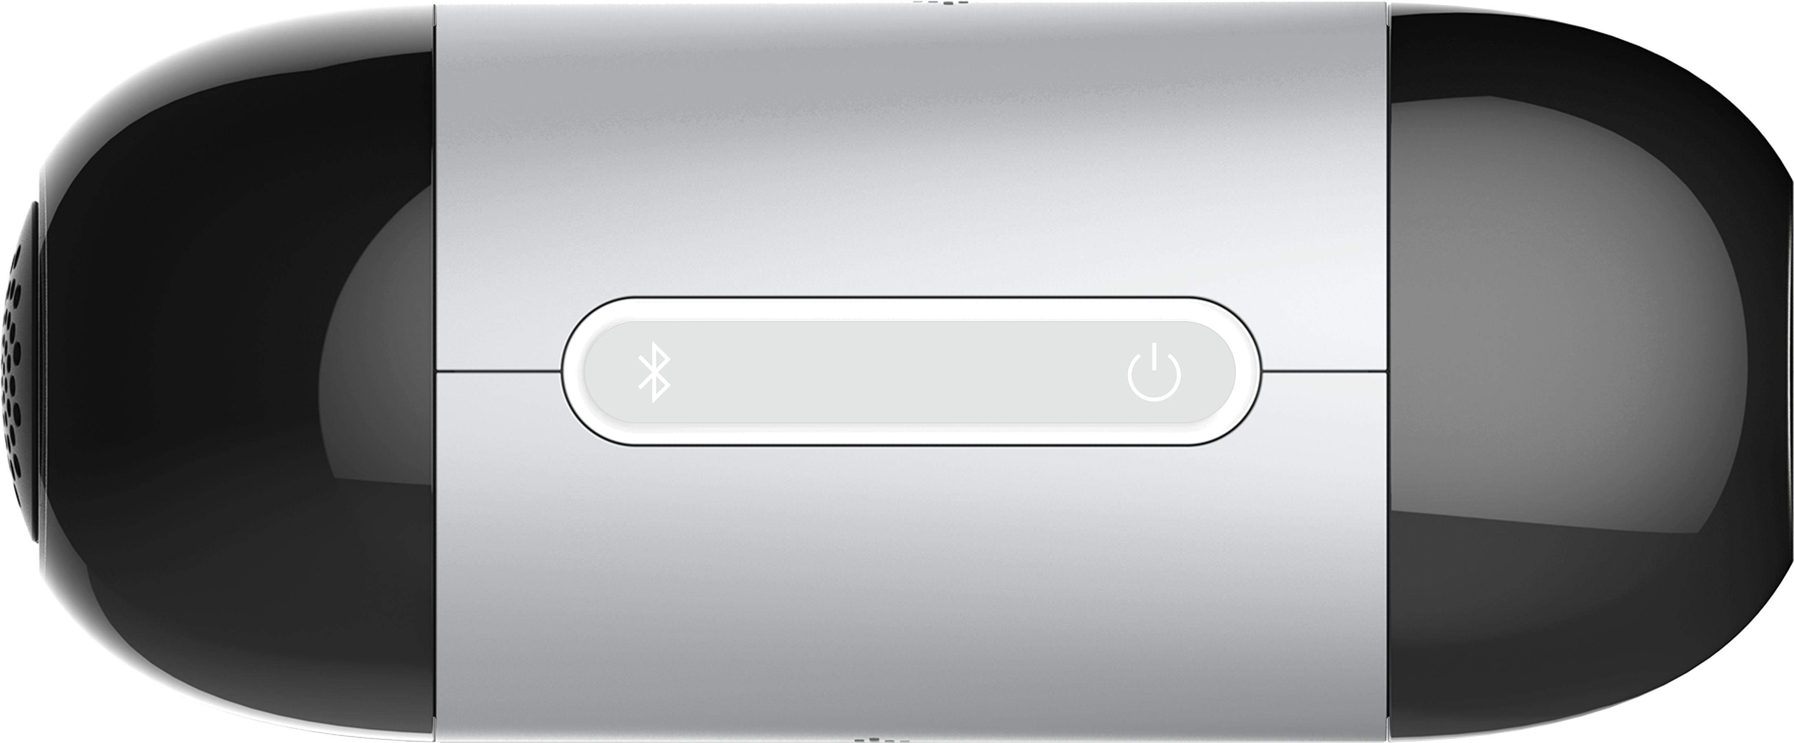
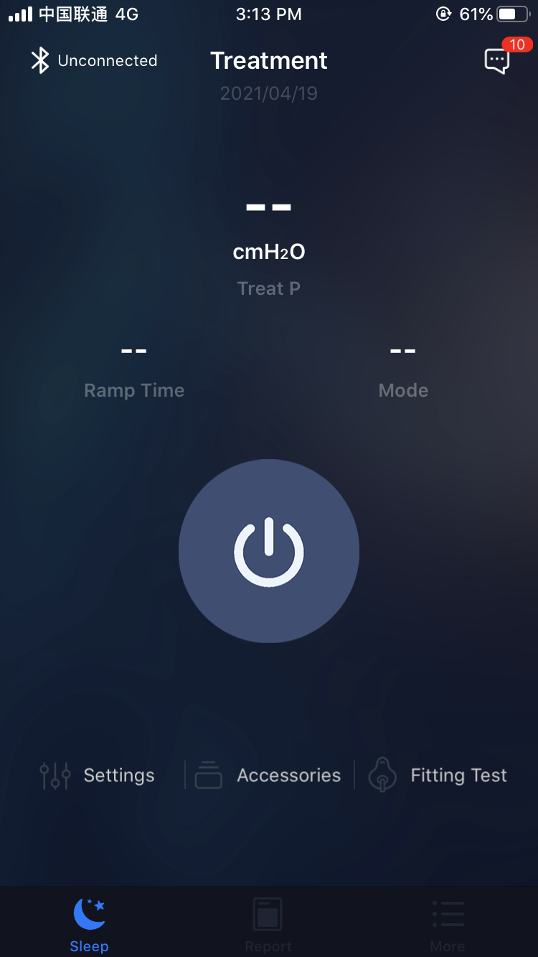
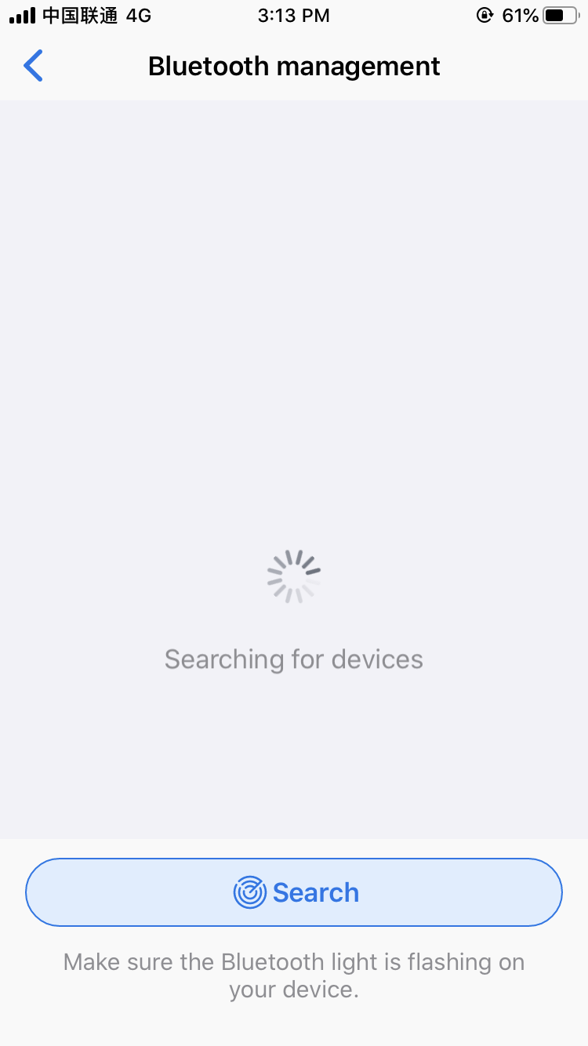
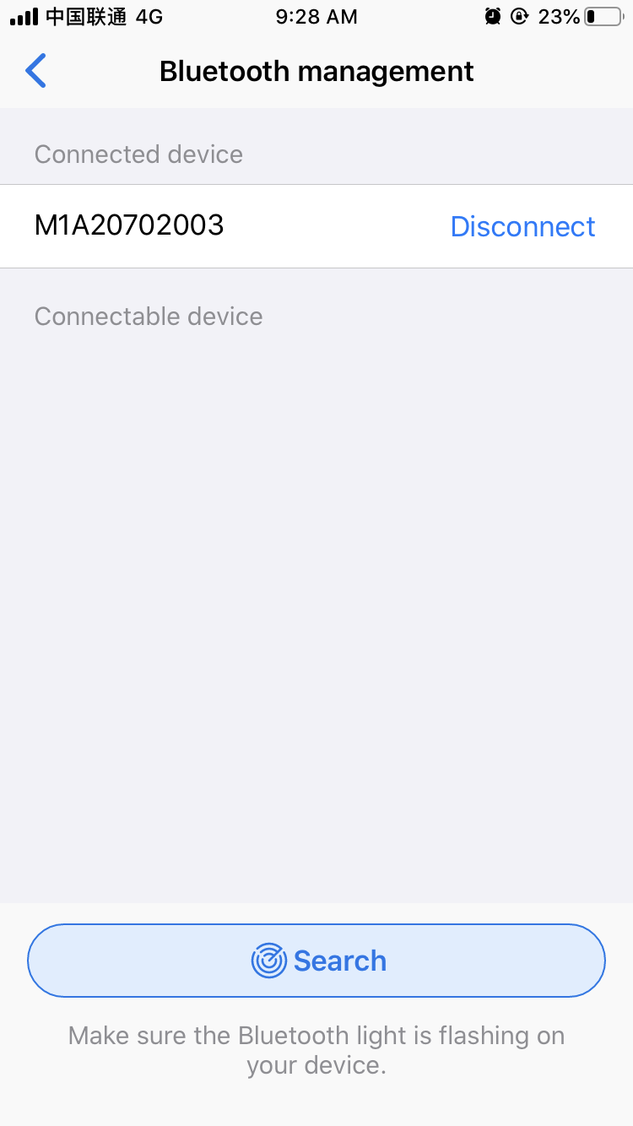
Bluetooth Management
4
If the indicator didn’t flash，
touch the Bluetooth icon.
After turning on，the Bluetooth indicator will be flash, meaning that the device is in the connecting state.

Slide 6
Bluetooth Management
4
If the indicator didn’t flash，
touch the Bluetooth icon.
After turning on，the Bluetooth indicator will be flash, meaning that the device is in the connecting state.

Slide 7
Bluetooth Management
4
If the indicator didn’t flash，
touch the Bluetooth icon.
After turning on，the Bluetooth indicator will be flash, meaning that the device is in the connecting state.

Slide 8

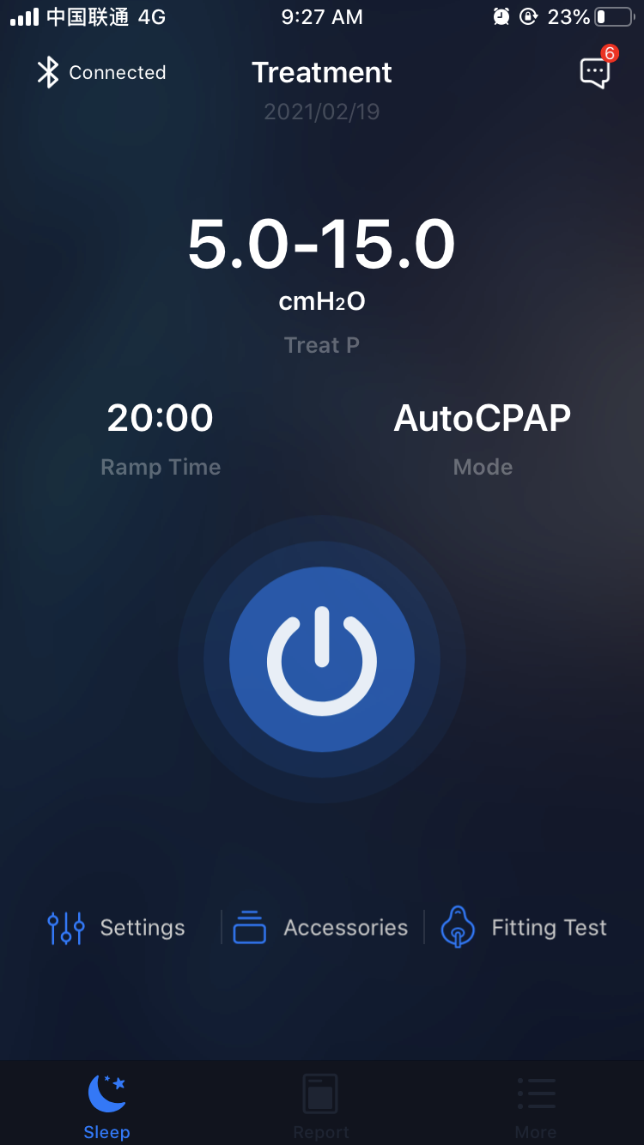








Description of Icon
5
 | Treatment icon: click to start or stop ventilation. (When Bluetooth is not connected, click this icon to enter the Bluetooth management interface)
 | Sleep icon: click it to enter into the sleep therapy interface.
 | Report icon: click it to enter the data report interface.
 | More icon: click it to enter into interface of more functions.
 | Bluetooth icon: click it to enter into the Bluetooth management interface.
 | Message icon: click it to enter into the message management interface.
 | Setting icon: click it to enter into parameter setting interface.
 | Accessories setting icon: click it to enter into the accessories setting interface.
 | Fitting Test icon: click it to enter into mask fitting test interface.

Slide 9
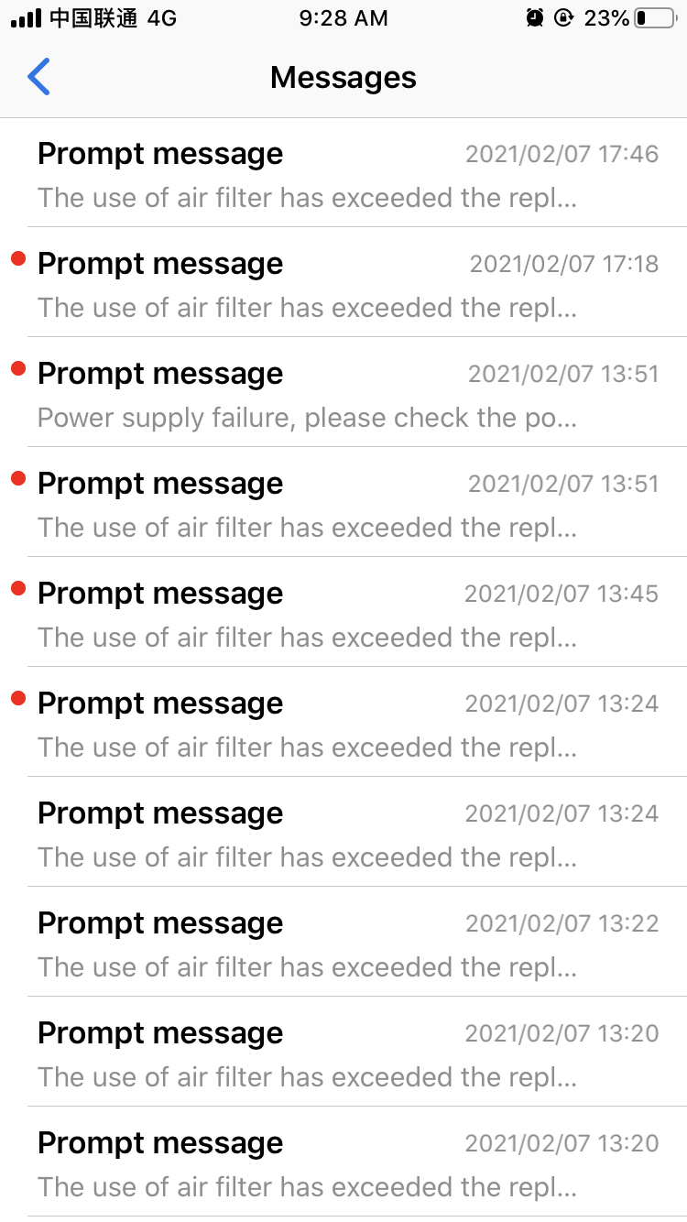
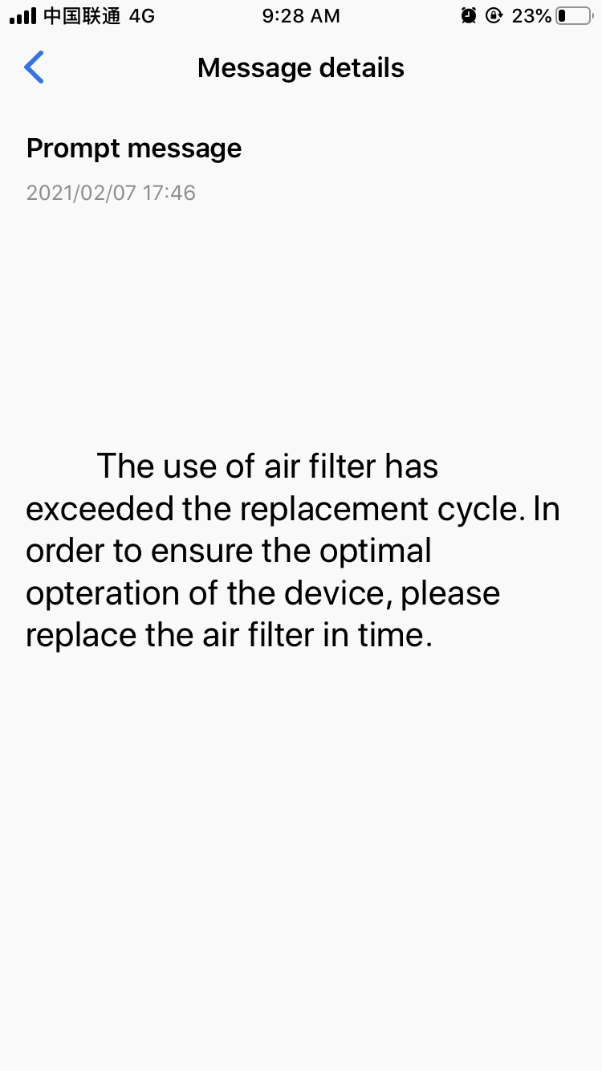

6
Message Management

Slide 10
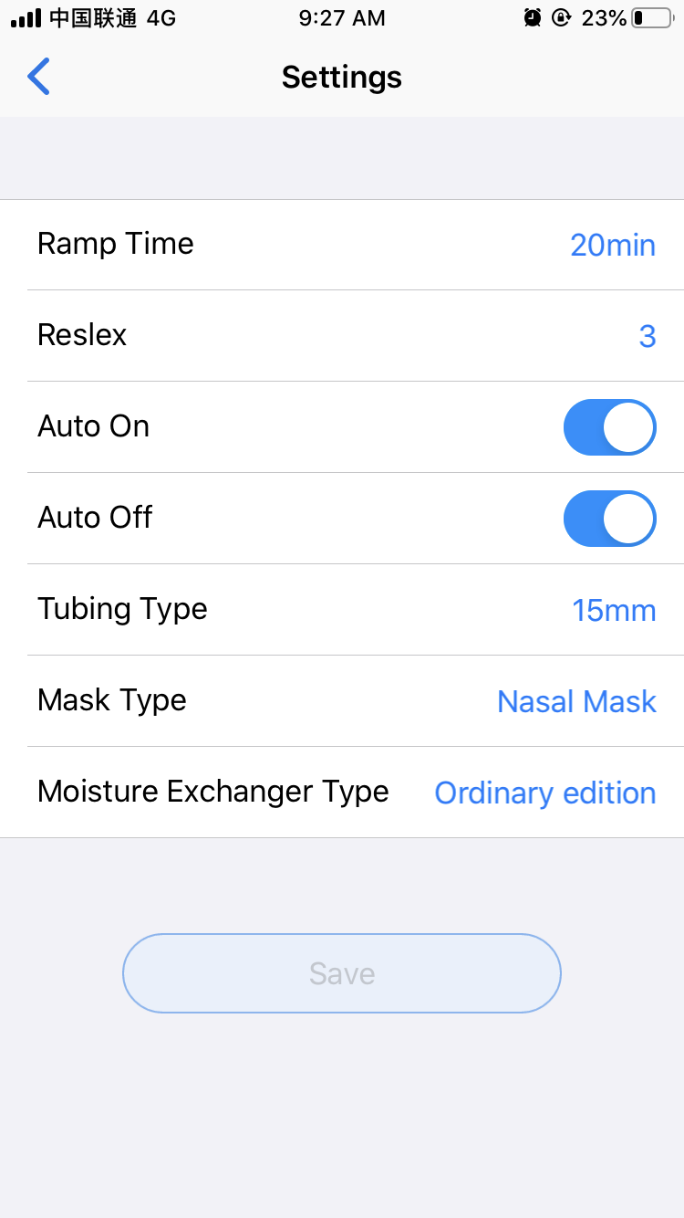

7
Settings

Slide 11
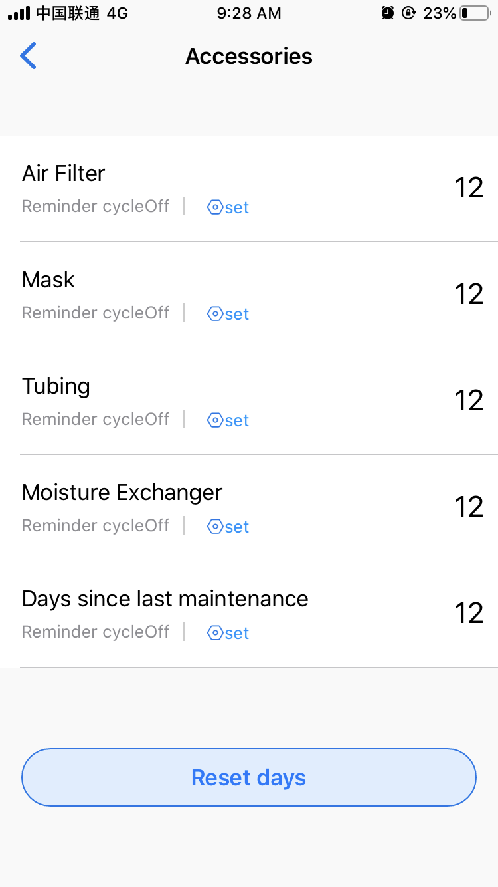

8
Accessories

Slide 12
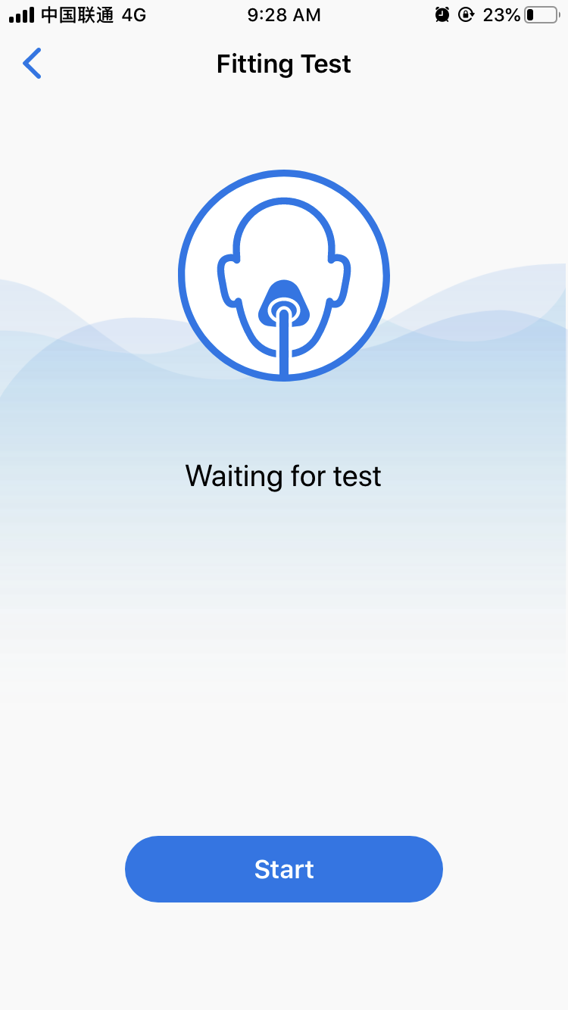
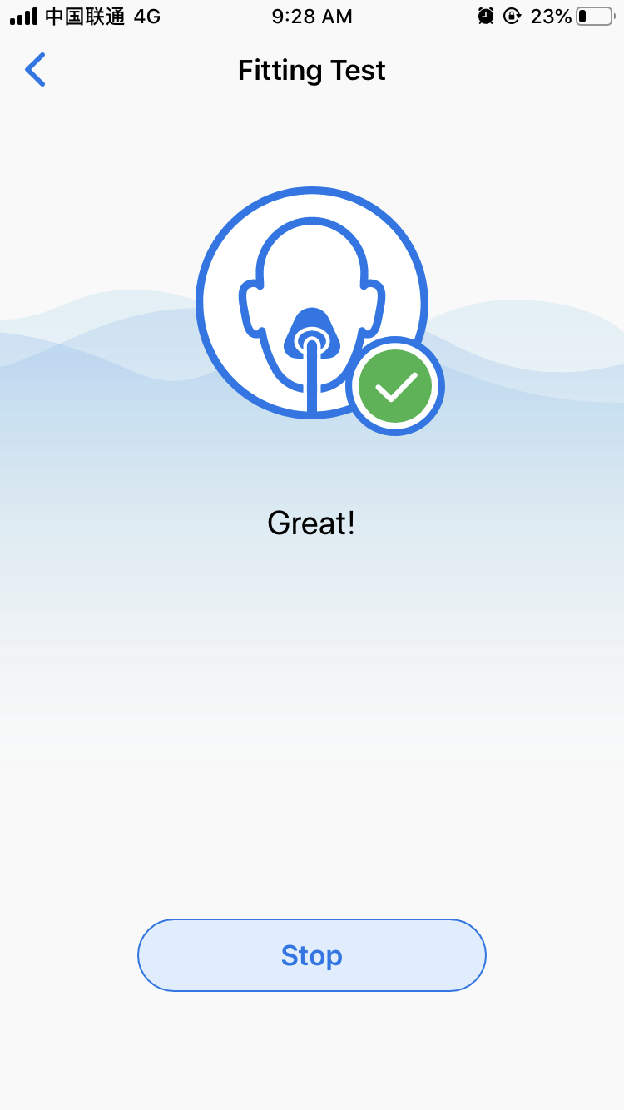

9
Fitting Test

Slide 13
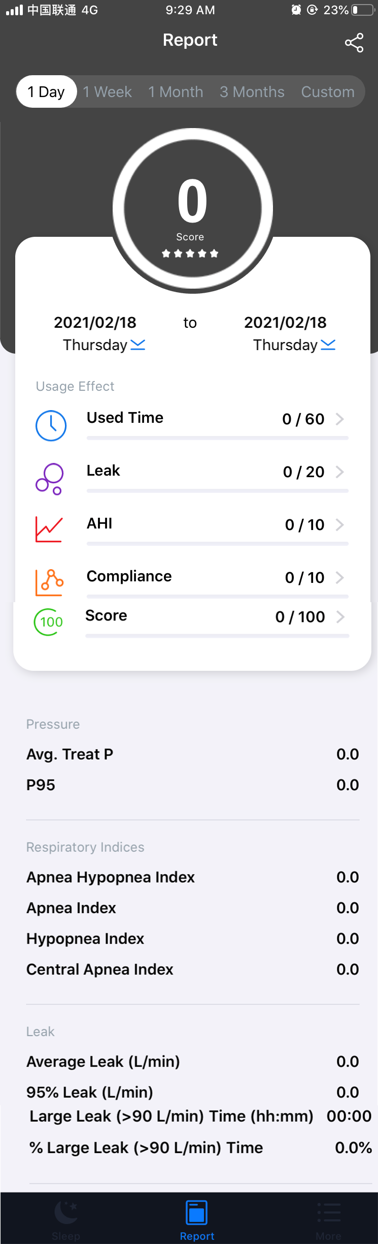
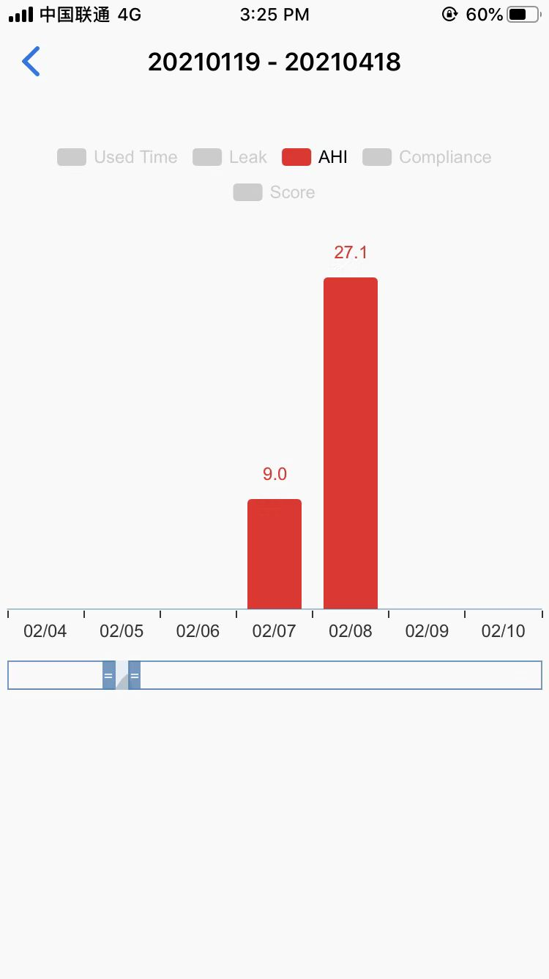


Sharing
10
Report Viewing and Sharing
View histogram

Slide 14
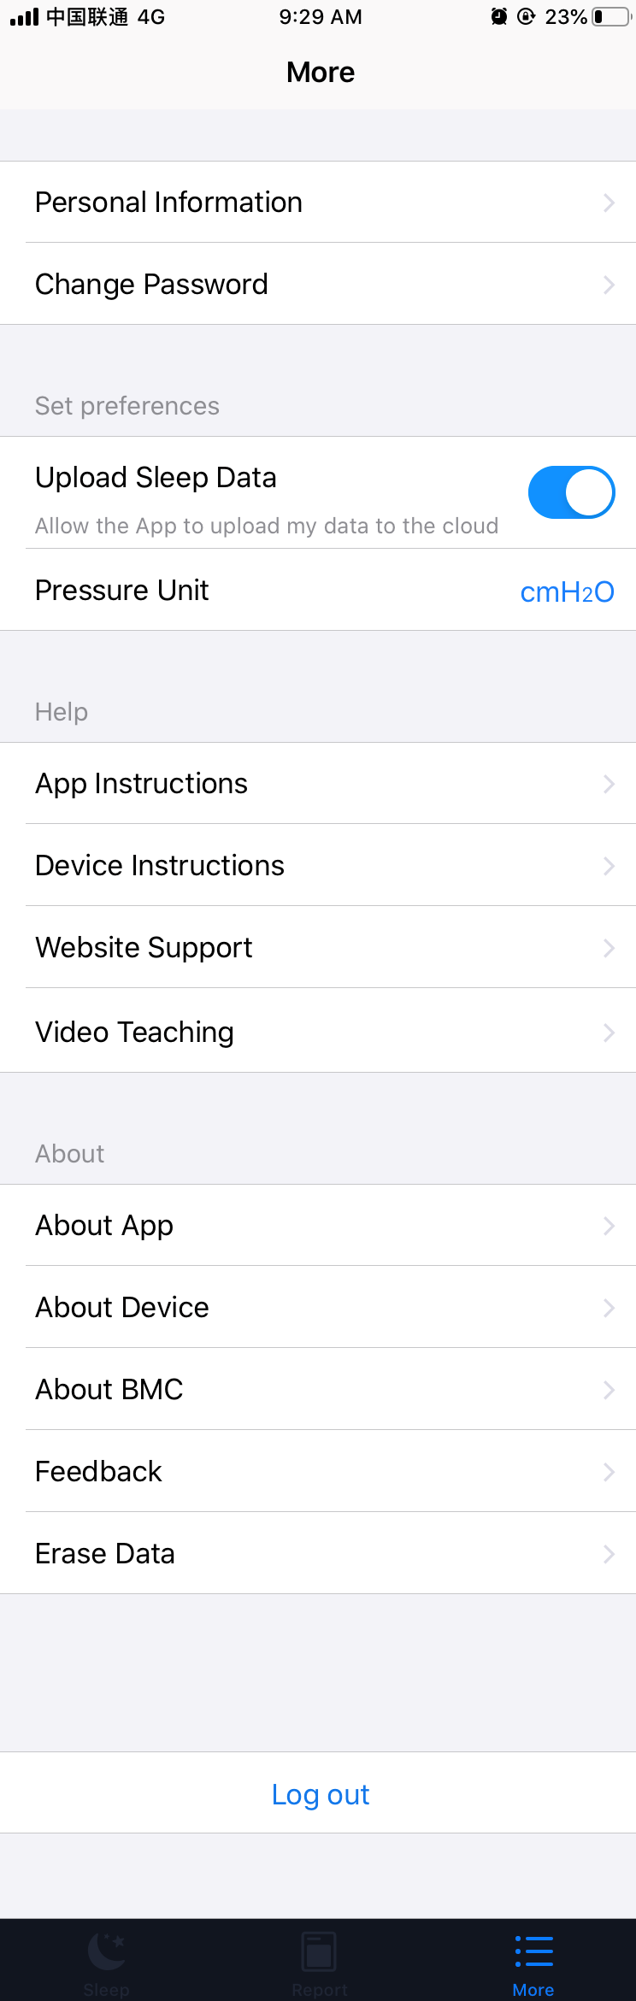

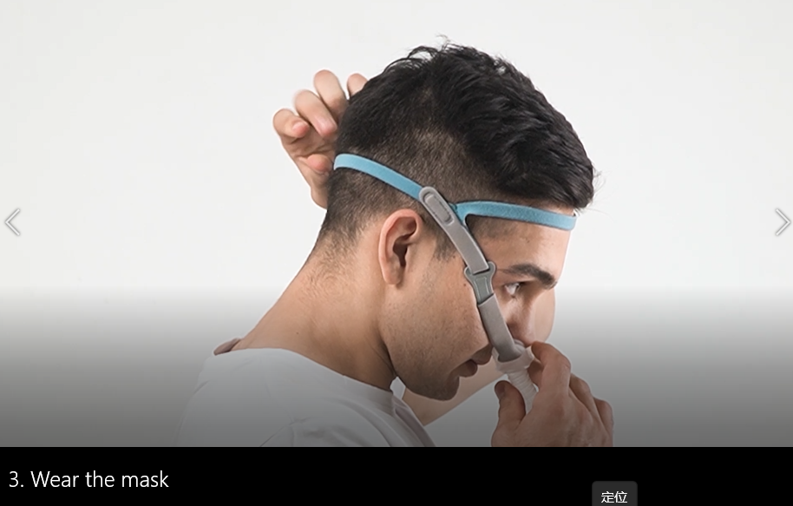
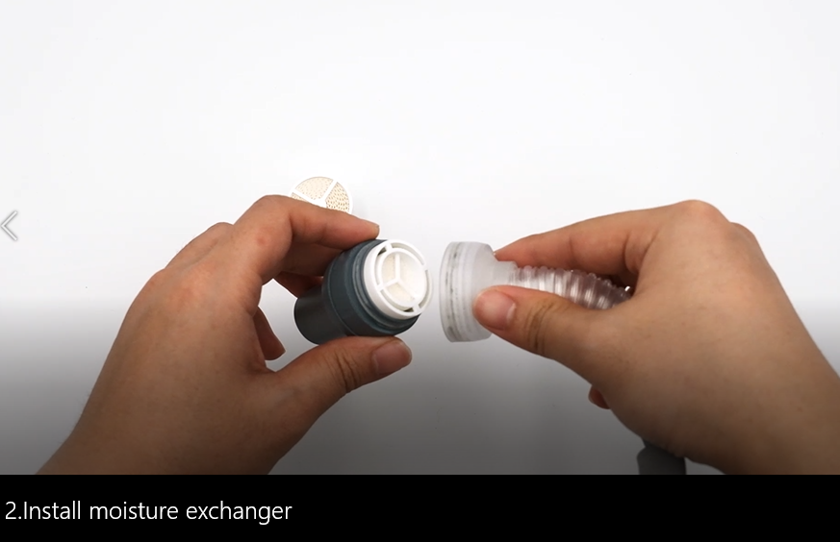
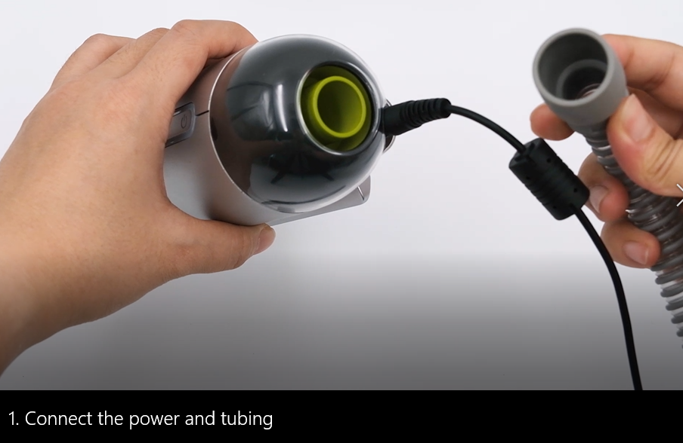

11
More

Slide 15
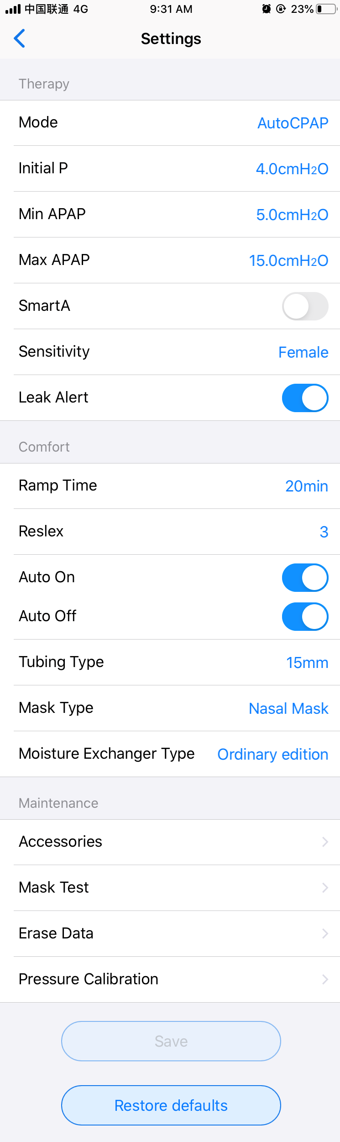
12
Clinical Menu
Click the two icons together and hold on for 5s

Slide 16
Thanks

